Slide 1
YEAR 9 CHEMISTRY
Atoms & bonding
How do tiny particles make
salt, water and everyday materials?
NaCl
H₂O
First thought: what do you think holds atoms together?
01
Notes:
Say: We are going to connect three things: what is inside an atom, what happens to its outer electrons, and how that changes a material. Work through slides 1–9 first. Take a break, then cover 10–14. Stop at each orange question and let the learner explain in her own words. The model diagrams simplify real atoms.
Worksheet: Atoms.pdf, Bonding & Compounds, Year 9 Chemistry, supplied by parent.
Sources:

Slide 2
WORKSHEET 1
Inside a sodium atom
Atomic number 11 Mass number 23
Particle | Where? | Charge | Number
Proton | Nucleus | +1 | 11
Neutron | Nucleus | 0 | 23 − 11 = 12
Electron | Around nucleus | −1 | 11 (neutral)
Why does a neutral sodium atom have 11 electrons?
02
Notes:
Say: An atom is the smallest unit of an element that keeps its chemical identity. Its nucleus contains positive protons and uncharged neutrons. Negative electrons occupy the space around it. Atomic number tells us the proton count. Mass number counts protons plus neutrons, not electrons. For this sodium-23 atom, 23 minus 11 gives 12 neutrons. A neutral atom has equal proton and electron counts. Ask: Why are there eleven electrons? Answer: Their negative charges balance eleven positive protons.
Worksheet: Atoms.pdf, Bonding & Compounds, Year 9 Chemistry, supplied by parent.
Sources:
https://openstax.org/books/chemistry-atoms-first-2e/pages/2-3-atomic-structure-and-symbolism
https://physics.nist.gov/PhysRefData/Handbook/Tables/sodiumtable1.htm

Slide 3
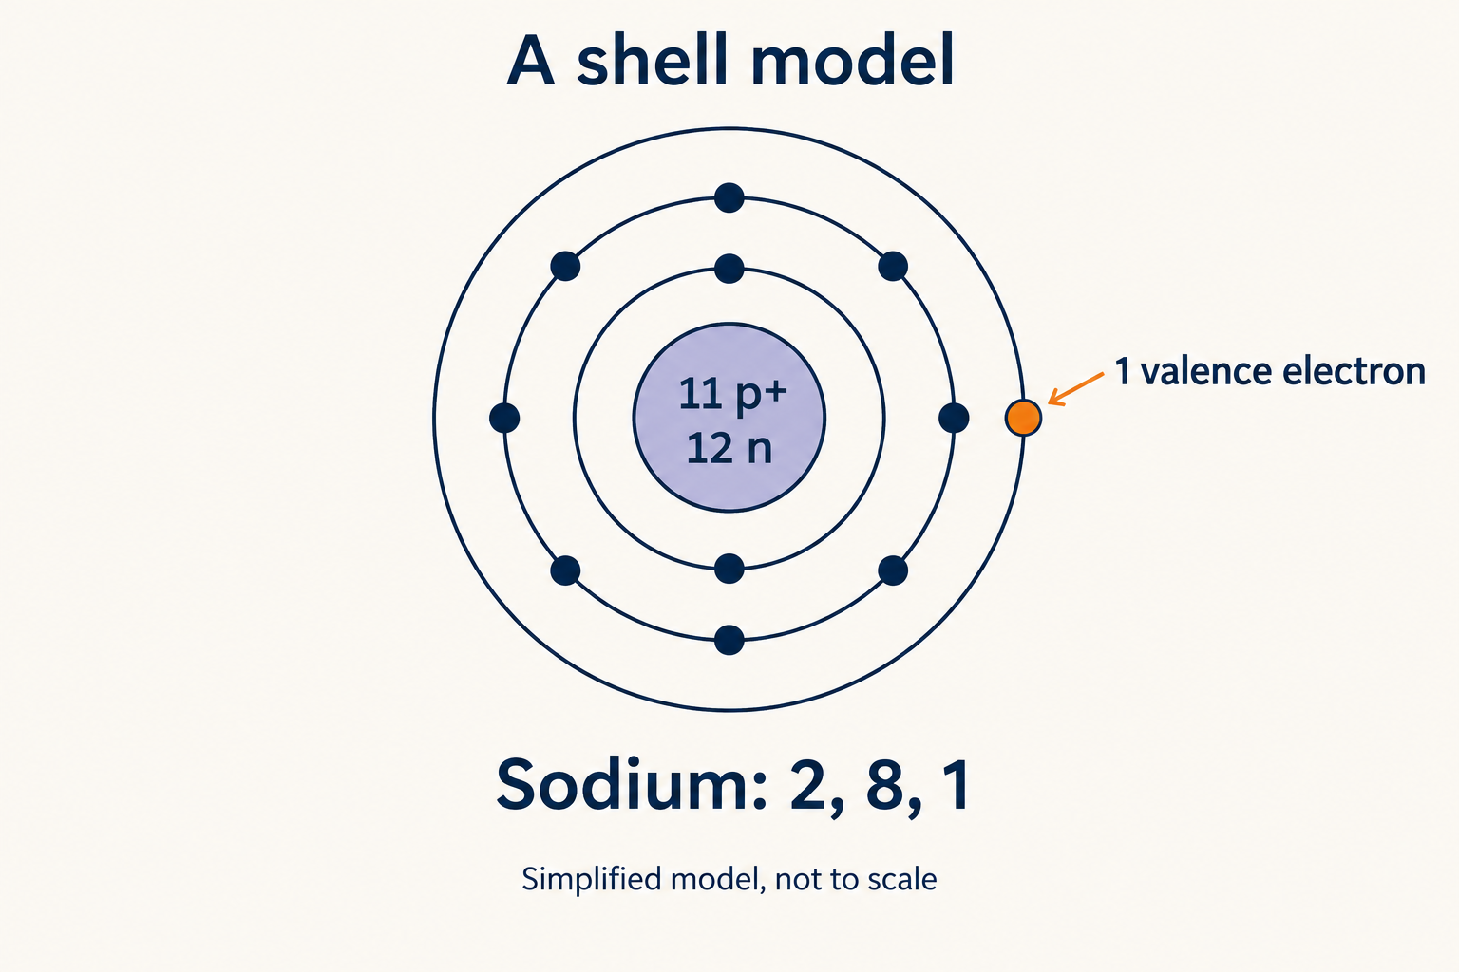
WORKSHEET 1
The outer electron matters
11 electrons
2 in the first shell
8 in the second
1 in the outer shell
Point to sodium’s valence electron.
03
Notes:
Say: Put sodium’s eleven electrons into this shell model: two in the first shell, eight in the second and one in the third. Count them together. The one in the outermost occupied shell is its valence electron. Rings are a school model of energy levels, not literal tracks travelled by electrons. The 2,8,1 pattern is sodium’s configuration, not a rule saying every shell holds eight. Ask: Which electron would sodium usually lose when forming an ion? Answer: The single outer electron.
Worksheet: Atoms.pdf, Bonding & Compounds, Year 9 Chemistry, supplied by parent.
Sources:
https://www.acs.org/middleschoolchemistry/lessonplans/chapter4/lesson5.html

Slide 4
WORKSHEET 1
Valence electrons and valency
Atom | Valence electrons | Usual valency here
Hydrogen | 1 | 1
Oxygen | 6 | 2
Sodium | 1 | 1
Chlorine | 7 | 1
Oxygen has 6 outer electrons. Why do we say its valency is 2?
04
Notes:
Say: These words sound similar but answer different questions. Valence electrons are the outer electrons. Valency describes combining capacity. In these simple examples it corresponds to the number of electrons lost, gained or shared in bonding. Oxygen has six outer electrons and usually forms two covalent bonds. Sodium has one outer electron and usually loses one to form sodium plus. Sodium’s valency is one, while its usual ion charge is plus one. Chlorine has seven outer electrons but valency one. Some elements have more than one valency, especially transition metals. Ask: Is oxygen’s valency six? Answer: No, its usual valency here is two.
Worksheet: Atoms.pdf, Bonding & Compounds, Year 9 Chemistry, supplied by parent.
Sources:
https://www.acs.org/middleschoolchemistry/lessonplans/chapter4/lesson4.html
https://goldbook.iupac.org/terms/view/V06588

Slide 5
WORKSHEET 2
Why bonds form
Attraction between electric charges
can hold particles together.
A stable bonded arrangement has lower energy
than the same atoms separated.
Full outer shells are a useful pattern, with exceptions.
Which particles carry positive and negative charge?
05
Notes:
Say: Atoms have no plans or wishes. A stable bonded arrangement has lower energy than the same atoms separated. Electrical attractions help hold particles together, while repulsions also matter. Full outer shells are a useful pattern for many simple examples. Hydrogen fits two in its first shell. The octet rule uses eight for many other outer shells, but it has exceptions. The worksheet’s nitrogen dioxide is one exception, so do not use it as a first dot diagram. Ask: What is the physical force involved? Answer: Electrostatic attraction.
Worksheet: Atoms.pdf, Bonding & Compounds, Year 9 Chemistry, supplied by parent.
Sources:
https://www.acs.org/middleschoolchemistry/lessonplans/chapter4/lesson4.html
https://www.acs.org/middleschoolchemistry/lessonplans/chapter4/lesson5.html
https://openstax.org/books/chemistry-2e/pages/7-3-lewis-symbols-and-structures

Slide 6
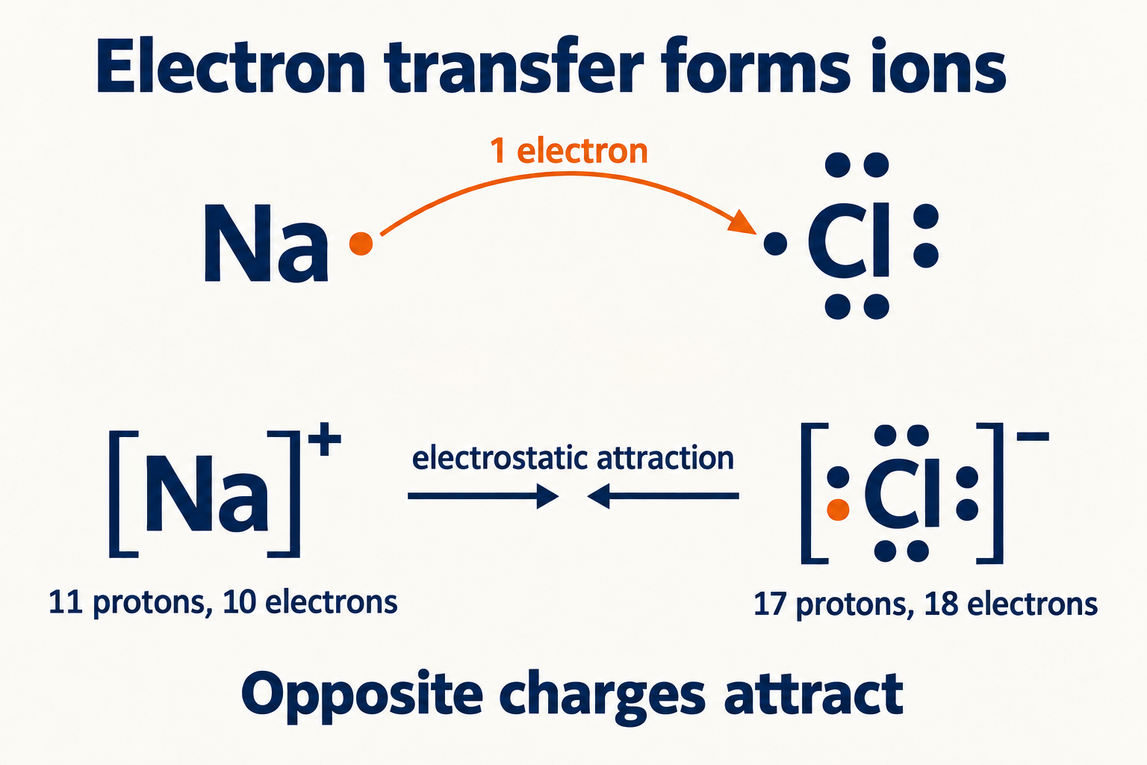
WORKSHEET 2
Ionic bonding
1 Transfer an electron
2 Form charged ions
3 Opposite charges attract
What is the bond: the transfer, or the attraction afterwards?
06
Notes:
Say: Sodium loses one electron. It still has eleven protons, but now only ten electrons, so its ion has a plus-one charge. Chlorine gains that electron and becomes a minus-one ion. Transfer makes ions. The ionic bond is the electrostatic attraction between opposite charges. In solid sodium chloride, many ions form a repeating lattice, rather than separate NaCl molecules. A dot’s colour only tracks its starting atom. All electrons are the same type of particle. Ask: Does sodium become a different element? Answer: No, its proton count stays eleven.
Worksheet: Atoms.pdf, Bonding & Compounds, Year 9 Chemistry, supplied by parent.
Sources:
https://www.acs.org/middleschoolchemistry/lessonplans/chapter4/lesson5.html

Slide 7
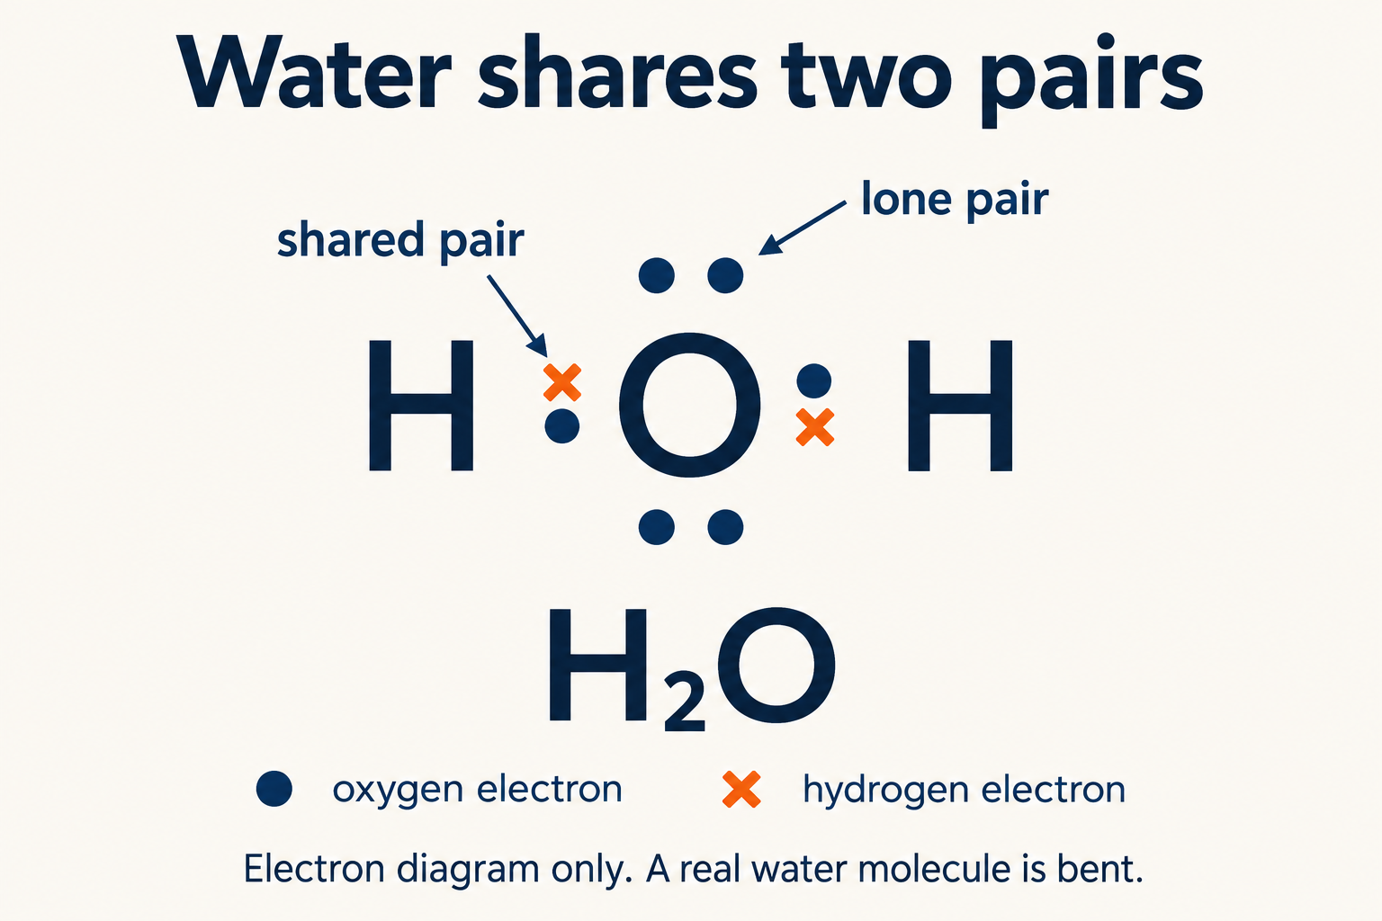
WORKSHEET 2
Covalent bonding
A shared electron pair
holds two atoms together.
Water has two O–H bonds.
Each bond = 2 electrons
How many shared electron pairs are in H₂O?
07
Notes:
Say: A covalent bond is a shared pair of electrons attracted to both bonded nuclei. In water, oxygen contributes six valence electrons and two hydrogens contribute one each. There are eight valence electrons in total. Four form two shared pairs. The other four form two lone pairs on oxygen. Count each shared pair around both atoms: each H counts two, and O counts eight. There are still only eight actual electrons in this valence diagram. The straight diagram shows electron bookkeeping, not water’s bent shape. Ask: How many shared pairs does water have? Answer: Two.
Worksheet: Atoms.pdf, Bonding & Compounds, Year 9 Chemistry, supplied by parent.
Sources:
https://www.acs.org/middleschoolchemistry/lessonplans/chapter4/lesson4.html

Slide 8
WORKSHEETS 2 & 3
Sorting and naming the compounds
Formula | Name | Worksheet classification
KCl | Potassium chloride | Ionic
H₂O | Water | Covalent
NO₂ | Nitrogen dioxide | Covalent
FeCl₃ | Iron(III) chloride | Ionic
CaCl₂ | Calcium chloride | Ionic
CO | Carbon monoxide | Covalent
What does the III in iron(III) chloride tell you?
08
Notes:
Let the learner predict each row before reading it. For these introductory examples, metal plus non-metal suggests ionic; non-metal plus non-metal suggests covalent. KCl is potassium chloride and ionic. H2O is water and covalent. NO2 is nitrogen dioxide and covalent. FeCl3 is treated as ionic at this level and named iron(III) chloride. The Roman numeral gives the iron ion charge, not the number of iron atoms. CaCl2 is calcium chloride. CO is carbon monoxide. Molecular prefixes include mono for one, di for two and tri for three; mono is usually omitted on the first element. Chloride is the ion name; chlorine is the element name. NO2 has an odd electron count and is an octet exception; keep it for classification and naming here.
Worksheet: Atoms.pdf, Bonding & Compounds, Year 9 Chemistry, supplied by parent.
Sources:
https://openstax.org/books/chemistry-2e/pages/2-7-chemical-nomenclature
https://openstax.org/books/chemistry-2e/pages/2-6-ionic-and-molecular-compounds

Slide 9
WORKSHEET 3
A formula must balance the charges
Ca²⁺ Cl⁻ Cl⁻
(+2) + (−1) + (−1) = 0
CaCl₂
Your turn: what formula balances Mg²⁺ and Cl⁻?
09
Notes:
Say: A compound is electrically neutral overall. One calcium ion has a plus-two charge. Each chloride ion has a minus-one charge. Two chlorides give minus two, which balances the calcium. The simplest ratio is one calcium to two chloride ions, so the formula is CaCl2. The small 2 counts chloride ions in the ratio. It does not mean chloride has a minus-two charge. Ionic formulas describe ratios in a lattice, rather than separate molecules. Ask: What formula balances Mg2+ and Cl−? Answer: MgCl2. Extension: Na+ and O2− give Na2O.
Worksheet: Atoms.pdf, Bonding & Compounds, Year 9 Chemistry, supplied by parent.
Sources:
https://openstax.org/books/chemistry-2e/pages/2-7-chemical-nomenclature

Slide 10
WORKSHEET 5
Structure explains properties
Property | Ionic substance | Simple molecular substance
Particles | Ions in a lattice | Separate molecules
Melting point | Usually high | Often low
In water | Many dissolve | Varies with substance
Conductivity | When ions can move | Usually poor
The worksheet’s covalent column is a simplified pattern.
Why can molten salt conduct, but solid salt cannot?
10
Notes:
Say: In an ionic lattice, strong attractions act between charged ions. In a simple molecular substance, covalent bonds hold atoms together within molecules, while weaker attractions often act between molecules. Melting a molecular substance usually overcomes attractions between molecules, not its covalent bonds. For ionic materials, mobile ions carry current when molten or dissolved; ions are fixed in the usual solid lattice. The worksheet gives broad patterns, not universal rules. Sugar dissolves despite being covalent. Diamond is a giant covalent structure with a high melting temperature, and graphite conducts. The molecular column does not describe every covalent material.
Worksheet: Atoms.pdf, Bonding & Compounds, Year 9 Chemistry, supplied by parent.
Sources:
https://openstax.org/books/chemistry-atoms-first-2e/pages/10-5-the-solid-state-of-matter
https://openstax.org/books/chemistry-2e/pages/2-6-ionic-and-molecular-compounds

Slide 11
WORKSHEET 5
Properties explain uses
Battery electrolyte
Wire coating
Mobile ions carry charge
through the electrolyte.
Insulating plastic has very few
mobile charge carriers, so it
resists electric current.
Finish: “Plastic suits wire coatings because…”
11
Notes:
Say: An electrolyte must carry charge through mobile ions. A suitable dissolved salt provides those ions. Battery chemistry determines which electrolyte works; this does not mean every salt suits every battery. A plastic wire coating, such as PVC, has very few mobile charge carriers, so it resists current and helps prevent shocks and short circuits. Plastic is a covalent polymer, made of long molecular chains. Its useful insulation does not depend on assuming that all covalent materials have low melting points. Ask her to use because in an answer.
Worksheet: Atoms.pdf, Bonding & Compounds, Year 9 Chemistry, supplied by parent.
Sources:
https://openstax.org/books/chemistry-2e/pages/11-2-electrolytes
https://openstax.org/books/chemistry-2e/pages/2-6-ionic-and-molecular-compounds

Slide 12
WORKSHEET 4
A fair flame test
Question | A useful answer
What changes? | The metal salt tested
What is observed? | The flame colour
What stays the same? | Sample amount and flame conditions
More valid? | Prevent contamination between samples
More reliable? | Repeat and check for consistent colours
Eye protection: splashes. Tied-back hair: ignition risk.
Does repeating a contaminated test make it valid?
12
Notes:
Say: The independent variable is the metal salt being tested. The dependent variable is observed flame colour. Keep sample amount and flame conditions consistent. For a stronger comparison, use salts with the same anion and the same concentration. Improve validity by preventing contamination with a fresh splint or appropriately cleaned loop, so colour comes from the intended sample. Improve reliability by repeating each test and checking whether colours agree. Wear eye protection against splashes and tie back hair to reduce ignition risk. Follow the teacher’s laboratory procedure; this slide is revision, not a home practical. Ask: Does repeating a contaminated test fix validity? Answer: No. It may repeat the same error.
Worksheet: Atoms.pdf, Bonding & Compounds, Year 9 Chemistry, supplied by parent.
Sources:
https://edu.rsc.org/experiments/flame-tests-the-wooden-splint-method/759.article
https://edu.rsc.org/resources/flame-tests-using-metal-salts/1875.article
https://edu.rsc.org/download?ac=519556

Slide 13
WORKSHEET 6
An extended answer needs “because”
Sodium chloride: ions in a lattice
Paraffin wax: covalent molecules in a mixture
Compare | Salt | Wax
Melting | High melting point | Melts easily: moulding
Water | Dissolves: brine | Insoluble: water barrier
Electricity | Dissolved ions: electrolyte | Poor conductor: insulation
Explain a property, give its particle reason, then link a use.
13
Notes:
Worked comparison: Sodium chloride contains positive and negative ions in a repeating lattice. Paraffin wax is a mixture of covalent hydrocarbon molecules. Salt has a much higher melting point because strong attractions hold its ions together. Wax melts more easily because attractions between its molecules are weaker; this makes wax easy to mould into candles. Salt dissolves in water and supplies ions, which is useful when making brine. Wax is insoluble and repels water, useful for water-resistant coatings. Dissolved salt conducts because ions can move, so appropriate salt solutions can act as electrolytes. Wax is a poor conductor because it has no mobile ions or delocalised electrons, allowing uses in electrical insulation or protective potting. A material is chosen for a combination of properties, and practical insulation also needs suitable heat resistance. Ask the learner to write her own paragraph connecting arrangement, each property and a use. A high melting point alone does not explain every use of salt.
Worksheet: Atoms.pdf, Bonding & Compounds, Year 9 Chemistry, supplied by parent.
Sources:
https://openstax.org/books/chemistry-atoms-first-2e/pages/10-5-the-solid-state-of-matter
https://pubchem.ncbi.nlm.nih.gov/compound/Paraffin
https://www.acs.org/education/whatischemistry/adventures-in-chemistry/science-abc/w-is-for-wax.html
https://openstax.org/books/chemistry-2e/pages/11-2-electrolytes

Slide 14
RETURN TO THE WORKSHEET
Can you teach it back?
1 Count the particles in sodium-23.
2 Explain valence electrons and valency.
3 Say what holds an ionic compound together.
4 Count the shared pairs in water.
5 Explain the 2 in CaCl₂.
6 Explain when salt can conduct electricity.
If you can explain it in your own words, try the worksheet.
14
Notes:
Keep the answers hidden in these notes. 1: Sodium-23 has 11 protons, 12 neutrons and 11 electrons when neutral. 2: Valence electrons occupy the outer shell; valency is combining capacity. Sodium has one of each in this example. 3: Ionic bonding is electrostatic attraction between oppositely charged ions. 4: Water has two shared pairs. 5: CaCl2 balances one Ca2+ with two Cl− ions. 6: Molten or dissolved salt has mobile ions that carry charge. If an answer is uncertain, return to that slide and have the learner draw or explain it. Praise the explanation process and let her correct the answer herself.
Worksheet: Atoms.pdf, Bonding & Compounds, Year 9 Chemistry, supplied by parent.
Sources:

